Slide 1

FIFA23 Analysis

Slide 2
PROBLEM STATEMENT
Building a Team to Beat Icons in FIFA 23
Data Collection and Preparation:
Gather player data including attributes like potential, position, and overall rating.
Organize data into structured formats for each team.

Slide 3
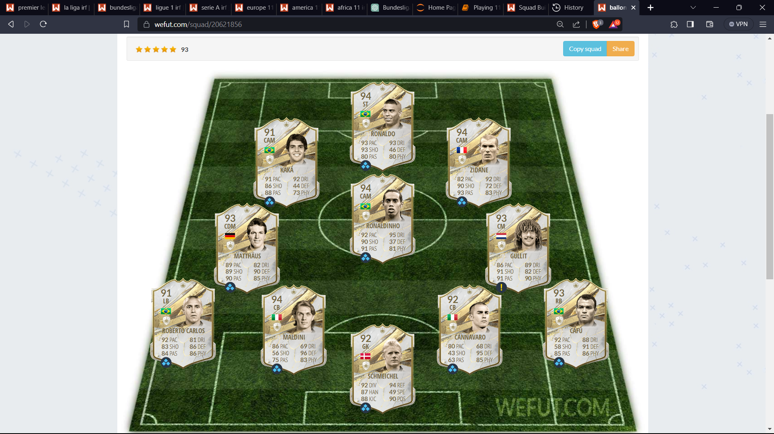
ICON 11 FC

Slide 4
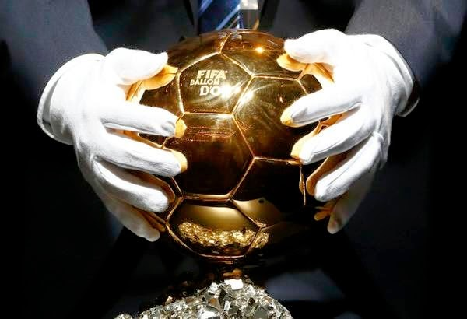
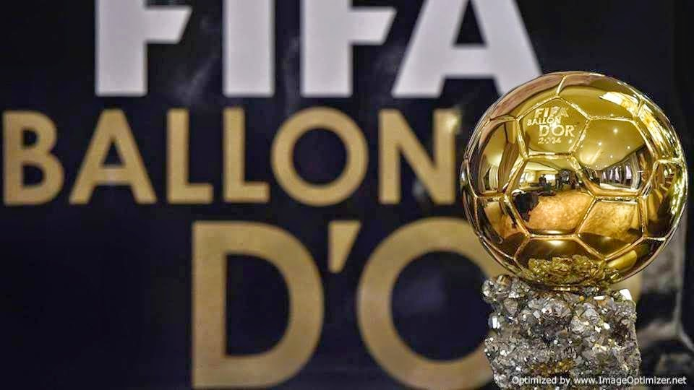
The Ballon d'Or is considered one of the highest honors in the football world, highlighting exceptional talent and contributions to the sport.
This Photo by Unknown Author is licensed under CC BY-NC-ND

Slide 5
1. **Web Scraping:** We started by scraping data from a website (footballtoday.com) that listed Ballon d'Or winners.
2. **Data Extraction:** We extracted information about Ballon d'Or winners, including their names, nationalities, and the years they won.
3. **Data Cleaning:** We cleaned the extracted data by removing unnecessary characters and formatting it into a more structured form.
4. **Data Storage:** We saved the cleaned data in a CSV (Comma-Separated Values) file for further analysis.
5. **Data Analysis:** We discussed various ways to analyze the data, including filtering winners from specific years and displaying the results.
6. **Data Filtering:** We filtered the list of winners to include only those who won between 1980 and 2007.
7. **Data Presentation:** We displayed the filtered data, showing Ballon d'Or winners from 1980 to 2007 in the Python output.
8. **Data Cleaning (Part 2):** We identified and cleaned gaps and empty spaces in the data to create a cleaner and more structured dataset.
9. **Excel Data Cleaning:** We discussed an Excel-based approach to cleaning data, specifically addressing the removal of blank spaces between values.
10. **Web Scraping (Part 2):** We mentioned the need to scrape additional data from Wikipedia, specifically the rankings of Ballon d'Or winners.
11. **Data Cleaning (Part 3):** We discussed further cleaning steps, such as removing NaN values in a structured dataset.
12. **Excel Data Cleaning (Part 2):** We provided an Excel formula to clean empty spaces between values in an Excel spreadsheet.
Throughout this project, we've been working with football-related data, cleaning it, and preparing it for analysis. We've also discussed various data analysis techniques and tasks that can be applied to similar projects in the future.

Slide 6
Football Team Building:
Develop criteria to select the best players for each position in a team.
Consider factors like overall rating, potential, and position compatibility.

Slide 7
Rules
Players used in one of 8 teams should not be repeated.
Choosing players position based on their chemistry.

Slide 8
Players Selection Criteria
This project is based on Fifa23 dataset where some of players may not be playing in the league as transfers occurring frequently.
Players are separated based on where they performed well.
There will be 8 teams and no substitute players.
It includes 3 main Continents and Europe’s top5 leagues.

Slide 9
Tournament and Team Selection
These 8 teams will compete each other.
For ultimate team selection, each player from their team who have highest potential increase based on their position is selected.
Winning team can have upto 3 players in their squad.
Runner up and Third place teams can have 2 players each.
No player from the last positioned team.
Other 5 teams can have 1 player each.

Slide 10
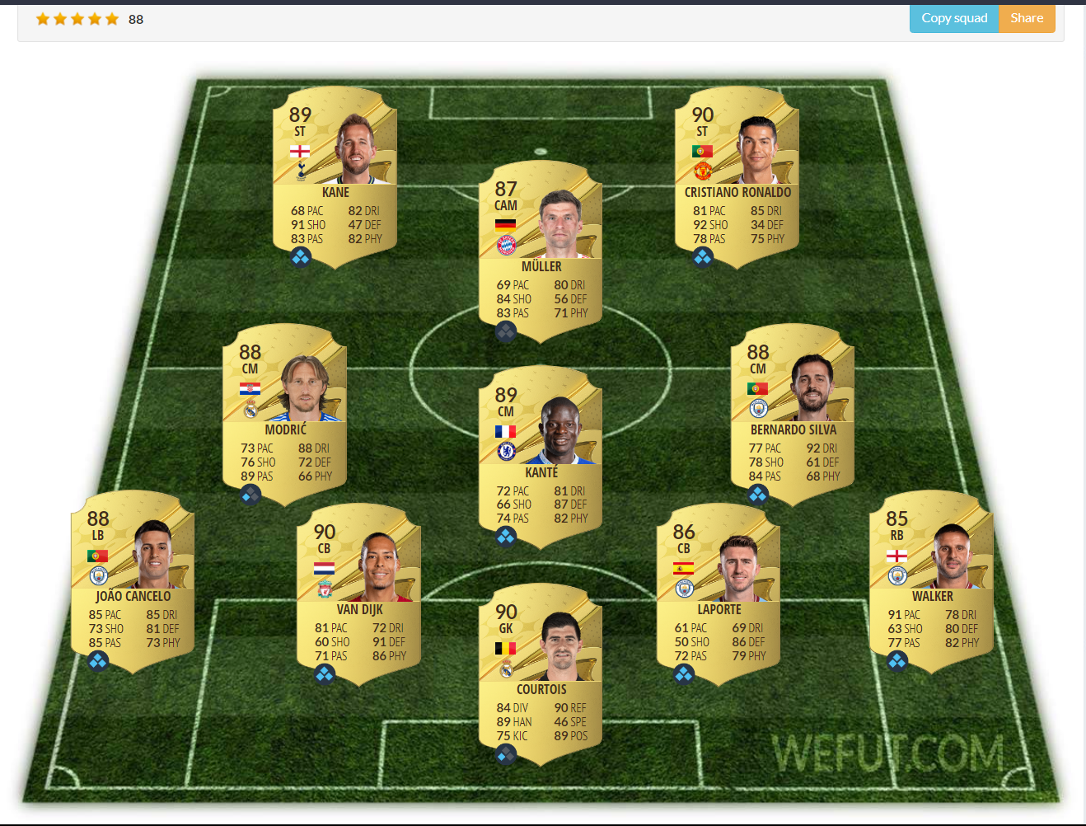
European Players

Slide 11
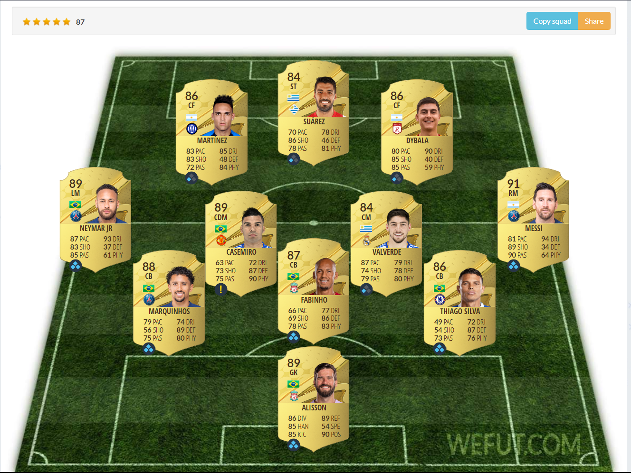
American Players

Slide 12
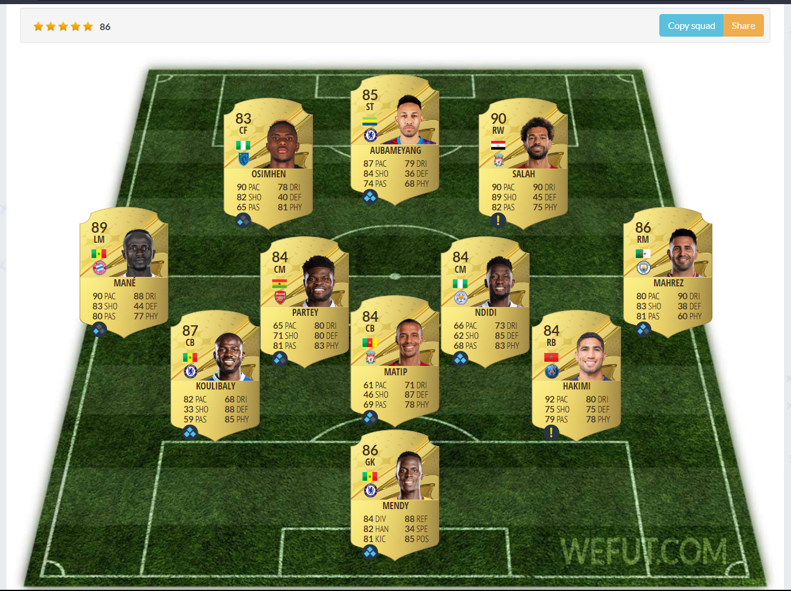
African Players

Slide 13
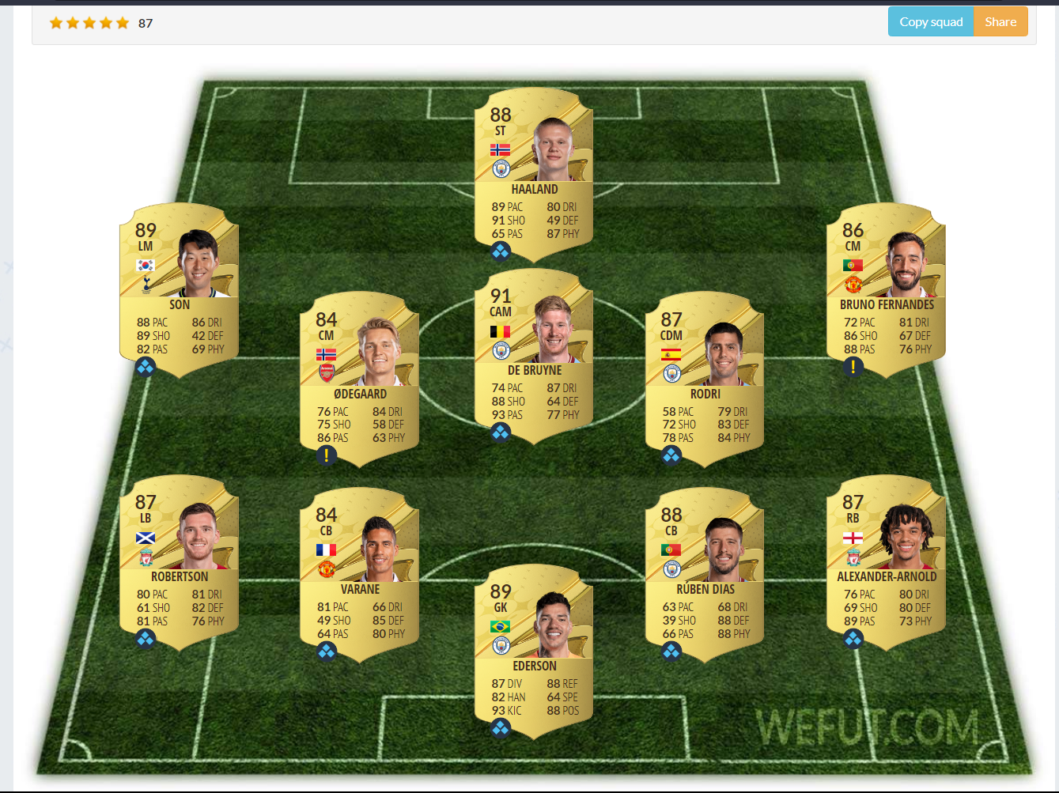
Premier League Players

Slide 14
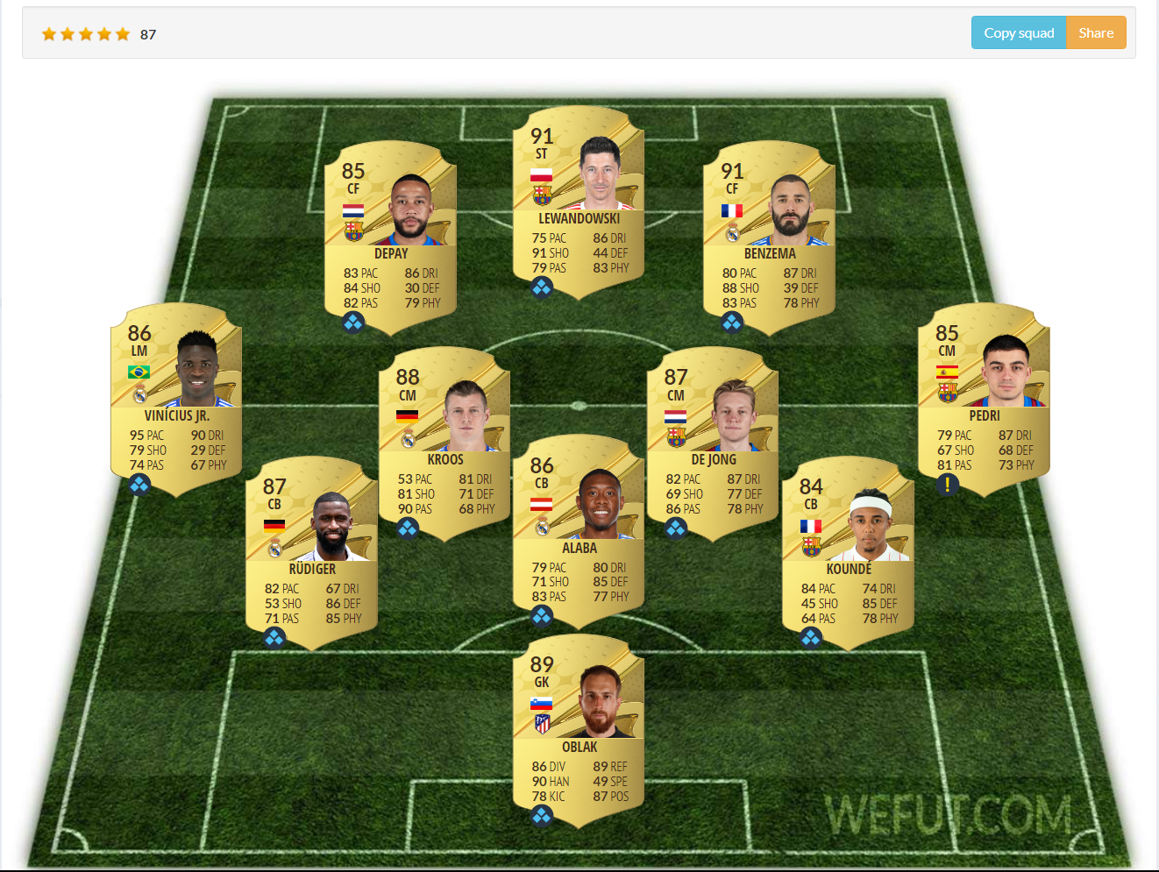
La Liga Players

Slide 15
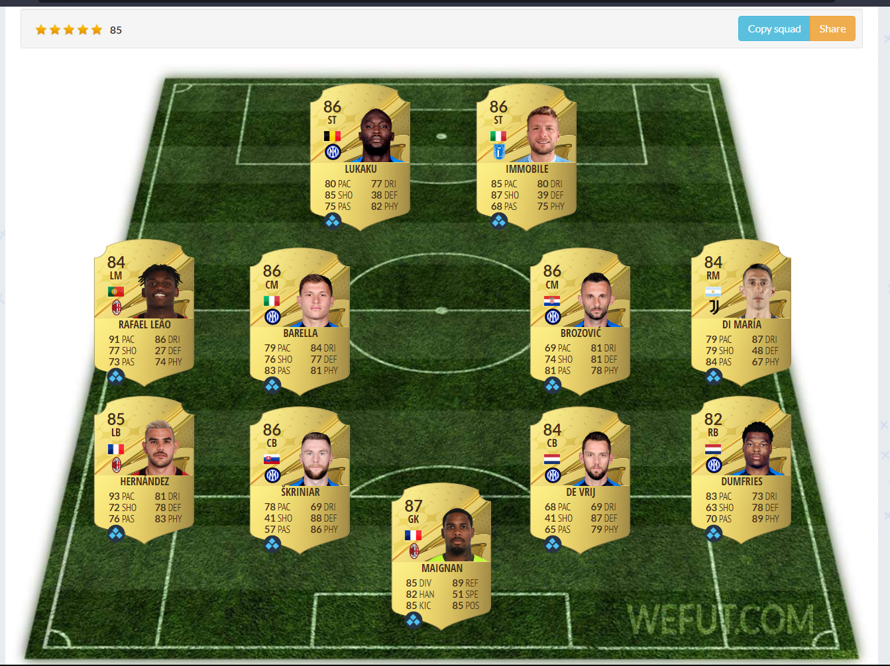
Serie-A Players

Slide 16
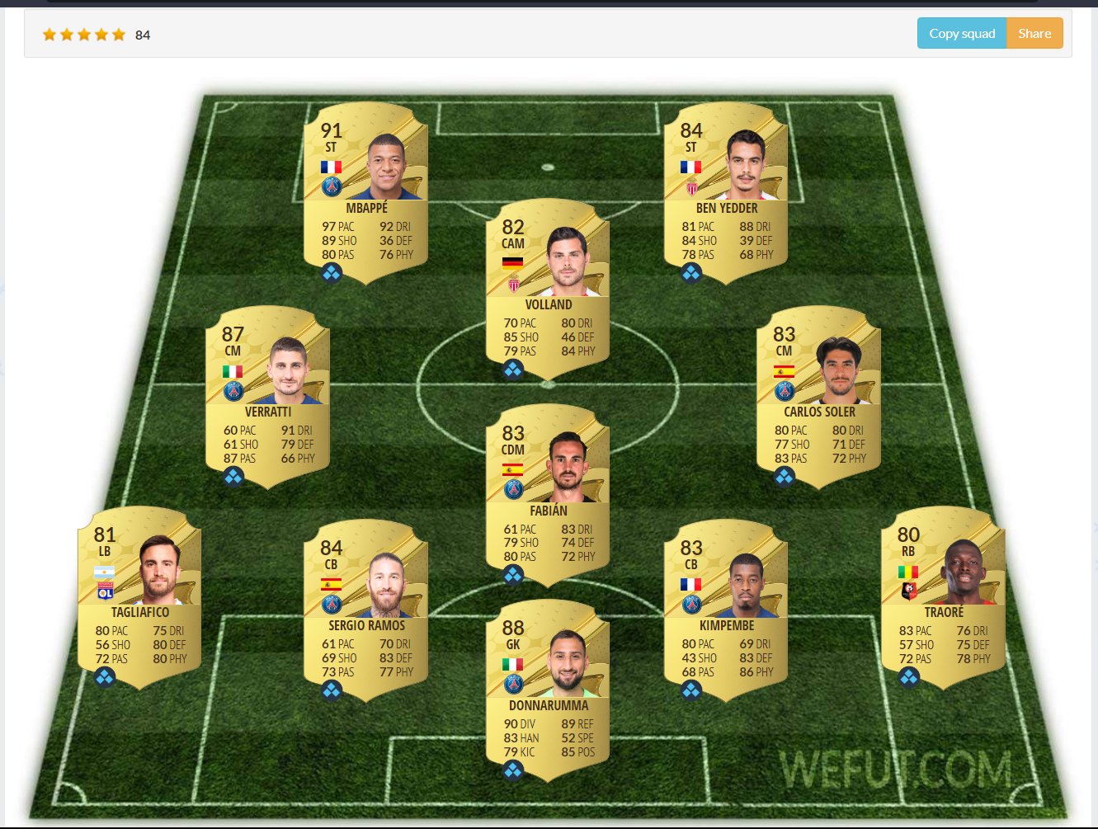
Ligue-1 Players

Slide 17
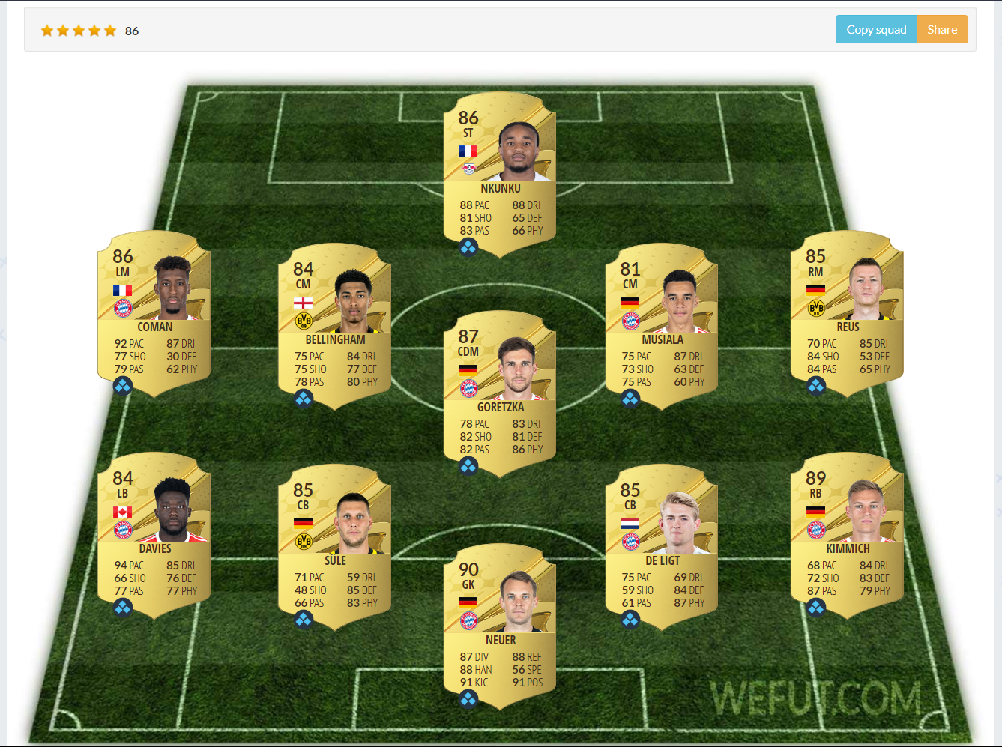
Bundesliga Players

Slide 18

Building final 11
As the tournament finished, the players form the winning team who have potential 90+ are filtered out.
As mentioned before 3 players from the winning team moves from base card to their potential card overall.
2 players from runner up and third position gets the boost.
1 player except the final positioned team gets boosted.

Slide 19
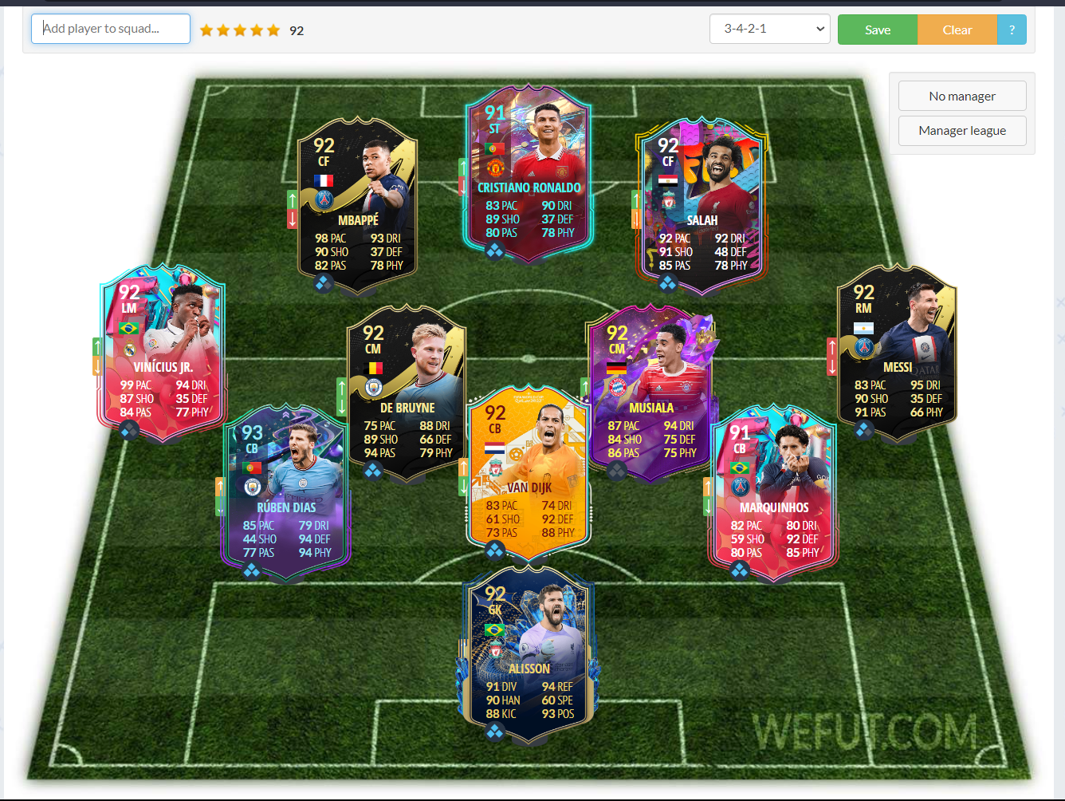
Ultimate 11

